Slide 1
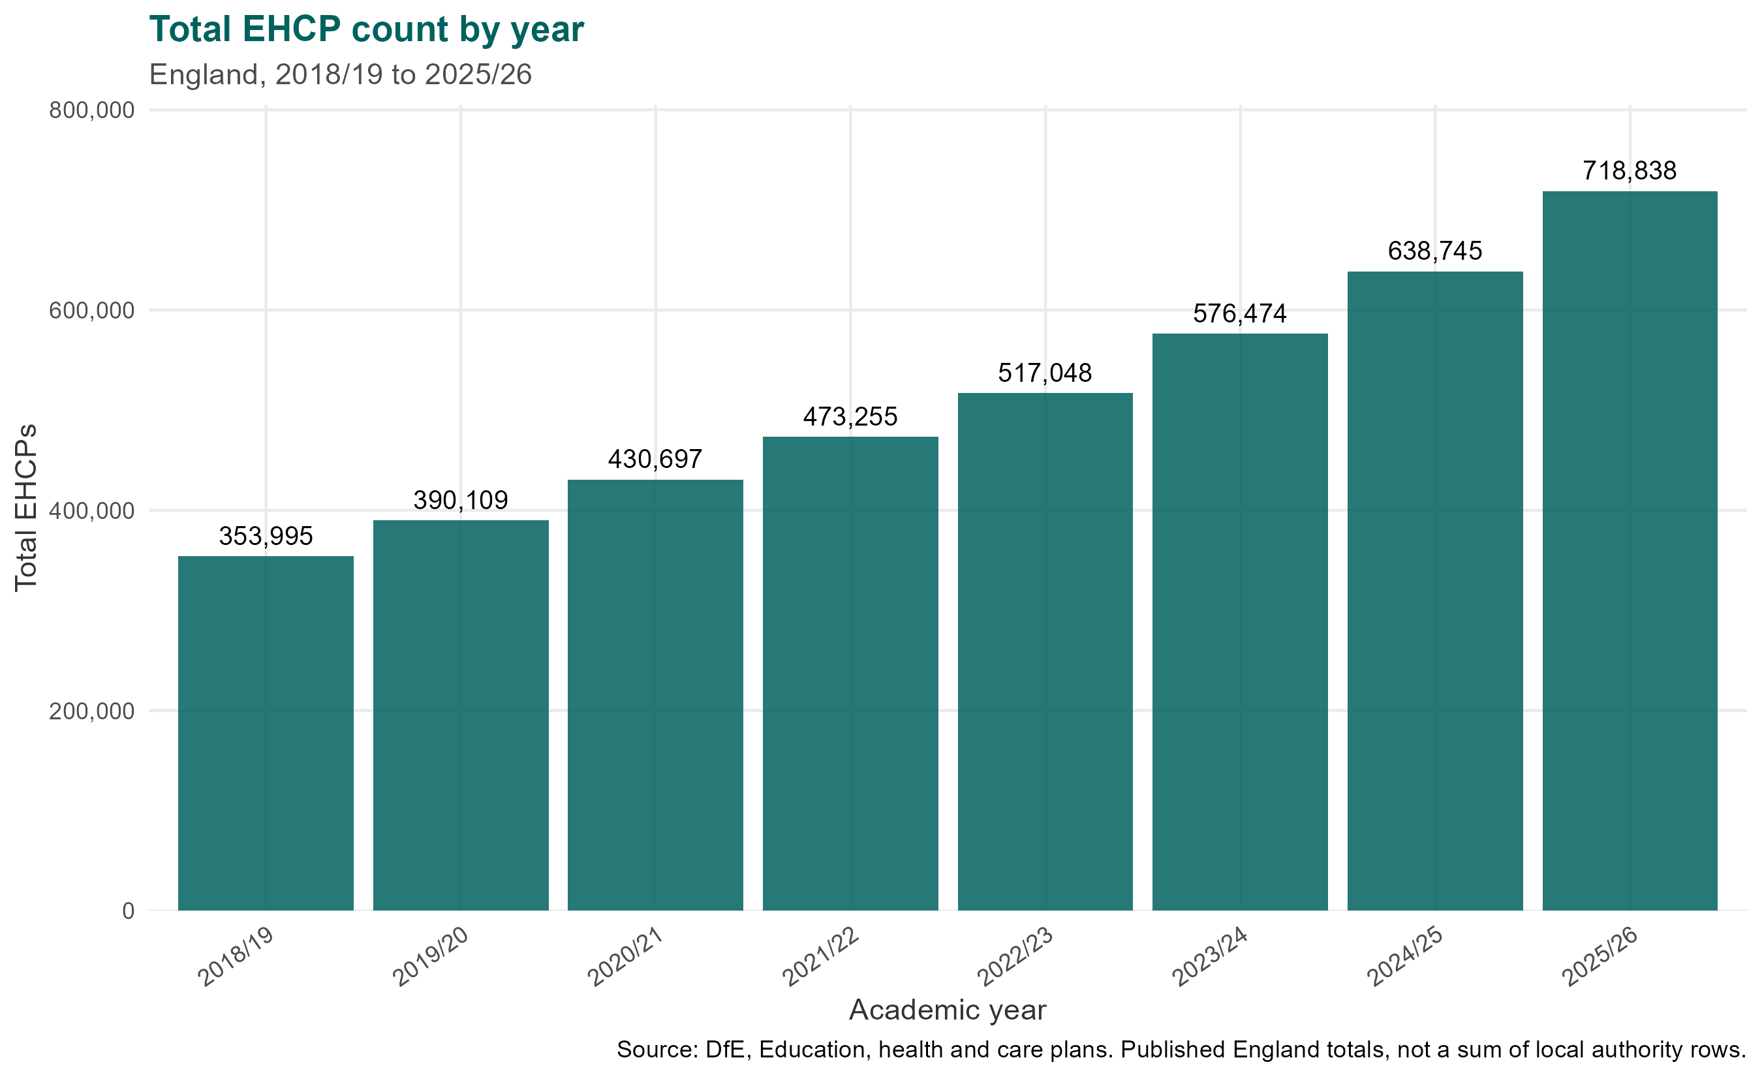
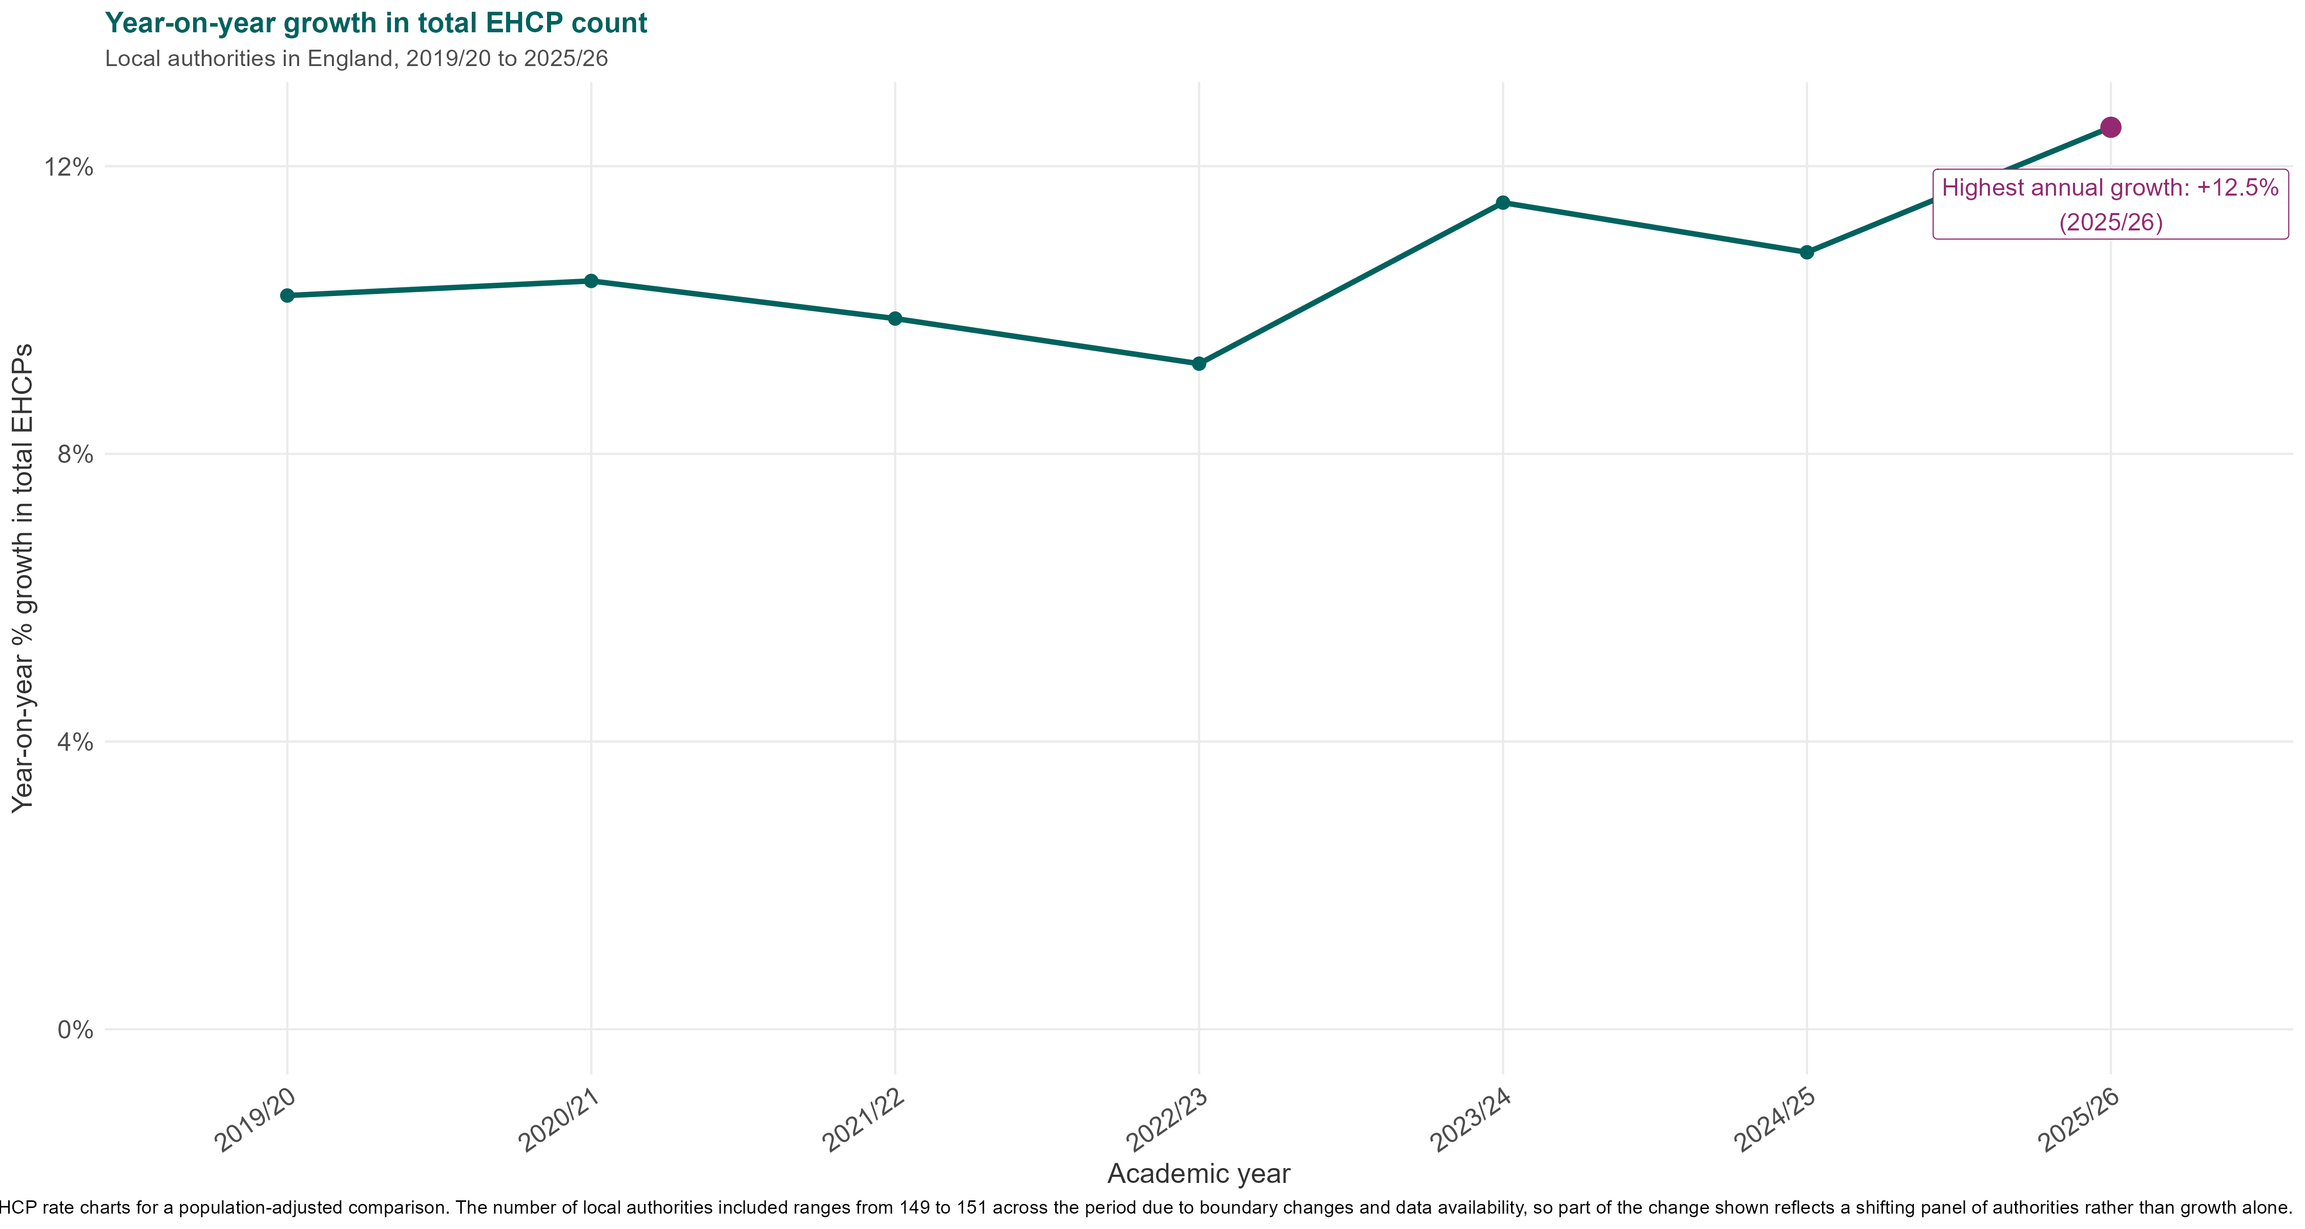
The number of children and young people with EHCPs has more than doubled since 2018 to reach 718,800 in 2026
The 12.5% increase in EHCPs over the latest year is the highest year-on year (YoY) increase since EHCPs were introduced
Since 2019, YoY EHCP growth has stayed above 9.2%, easing slightly during the pandemic period before climbing to a record 12.5% in the latest year.
*EHCP counts reflect the position as at the January census date each year, not a cumulative or annual total. Year-on-year comparisons therefore capture change between census snapshots rather than activity across the full reporting year.
Ha

Slide 2
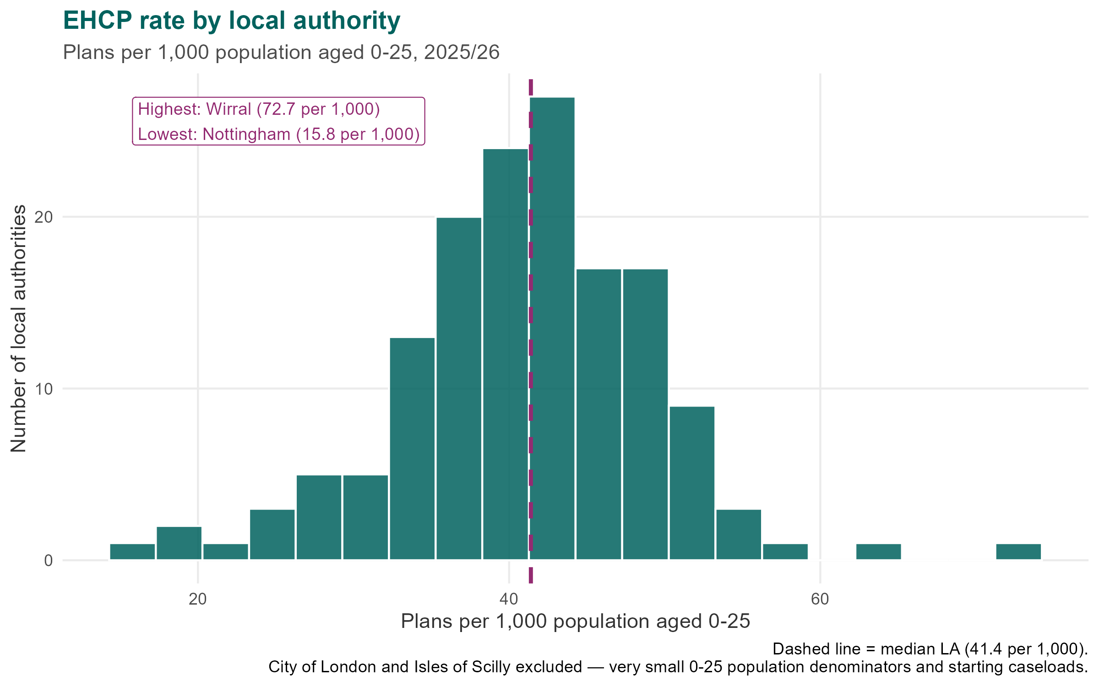
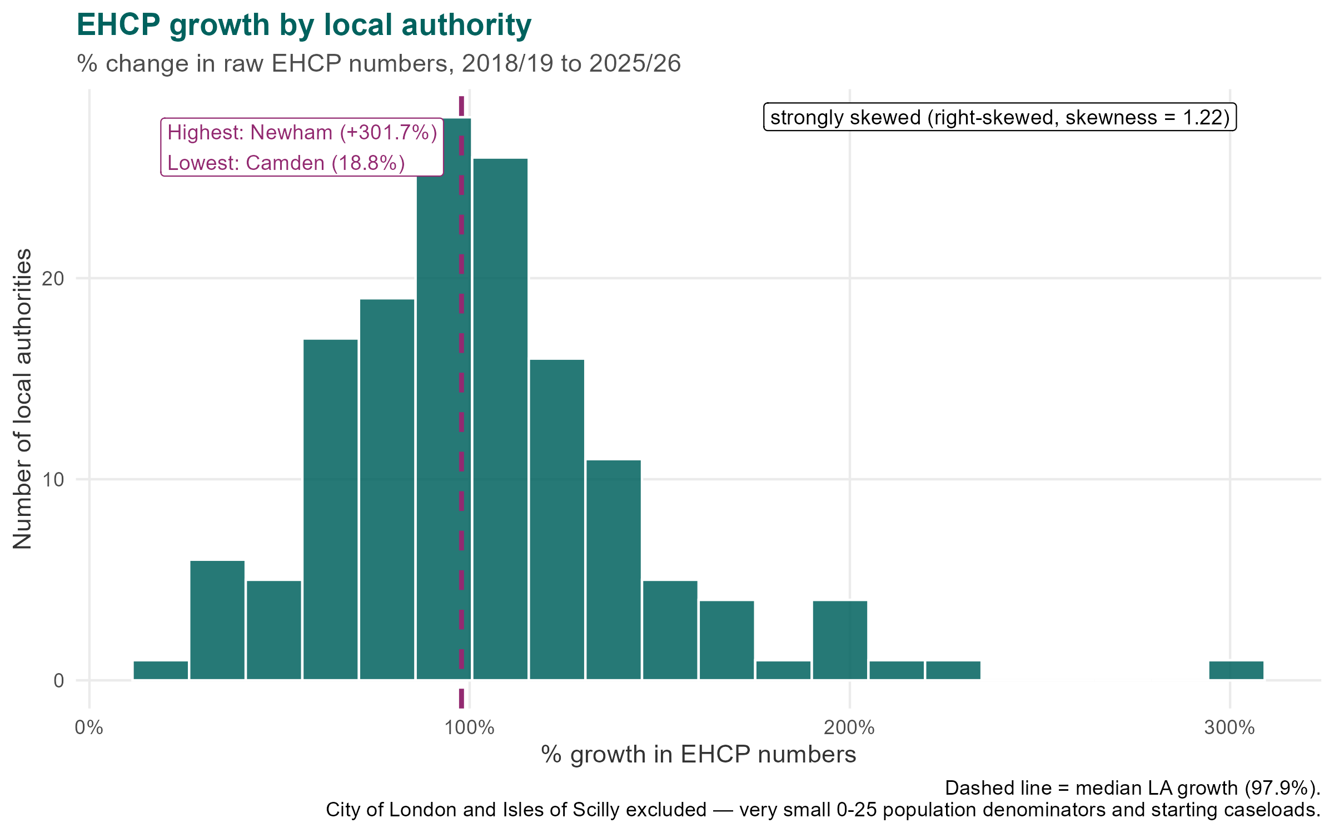
In 2026 the median LA EHCP rate was 4.1% of the 0–25 population, ranging from 1.6% to 7.3%
Growth since 2019 was equally uneven — median 98%, ranging from 19% to 302%, with half of LAs between 78% and 122%
Growth is happening everywhere. The typical local authority's EHCP caseload has roughly doubled since 2018/19. This is a national pattern, not a handful of outliers. The slowest growing area rose by 19% over the period; the fastest by 302%. Even setting the extremes aside, half of areas fall somewhere between 78% and 122%.
Large discrepancies between LAs. In 2025/26 the highest local authority supports 73 plans per 1,000 young people; the lowest supports 16 — more than four times the difference.
Source: MHCLG analysis of DfE EHCP data and ONS mid-year population estimates. City of London and Isles of Scilly excluded as small-number outliers.
Call-out: highest and lowest EHCP rates in 2026 — [LA] at [X]% and [LA] at [X]% (excl. CoL / IoS).

Slide 3
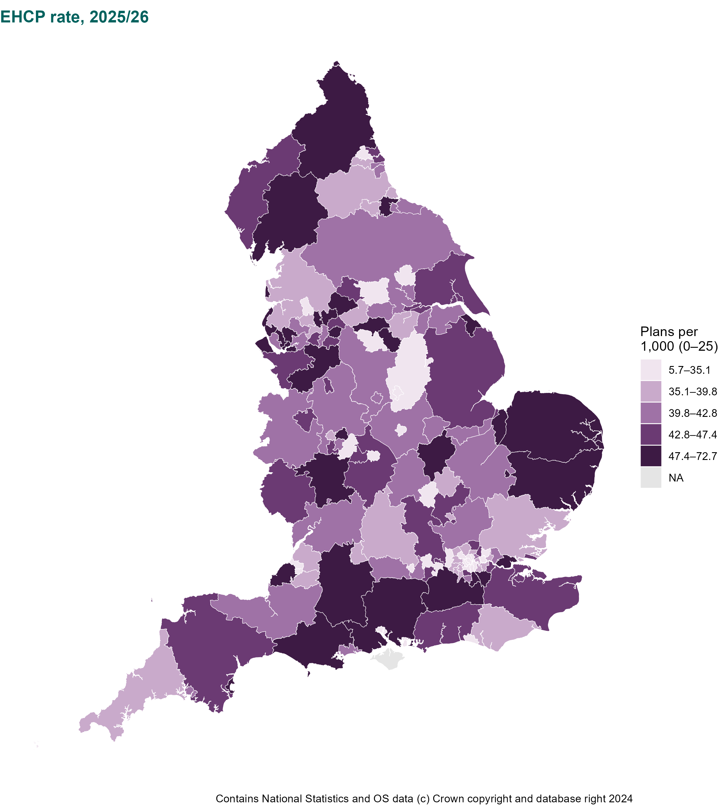
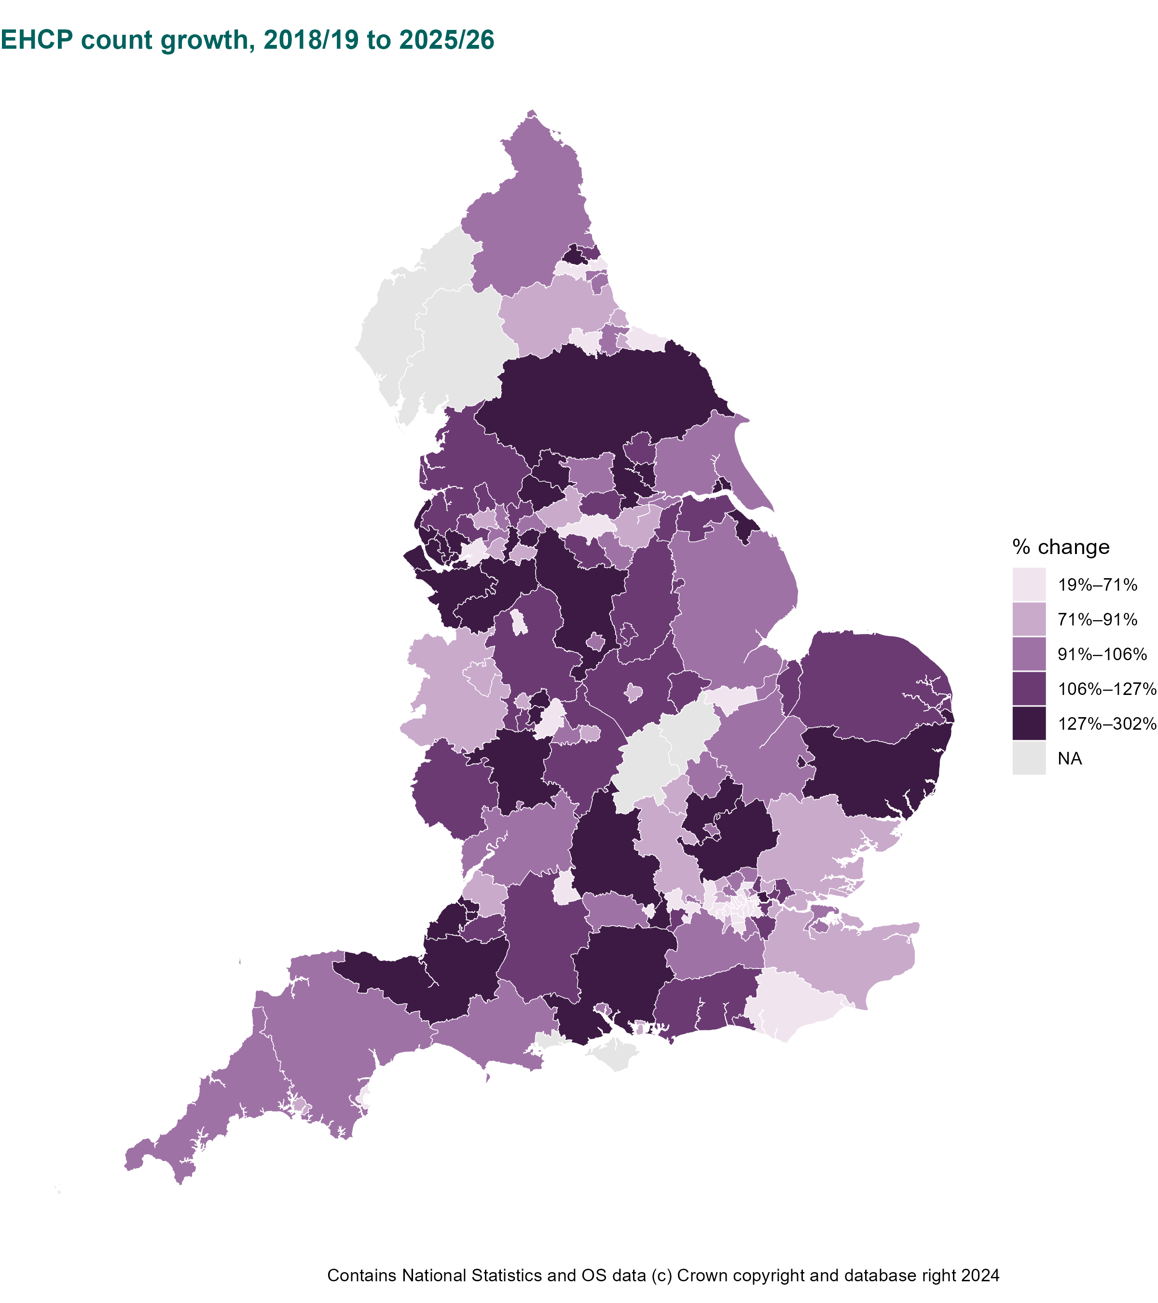
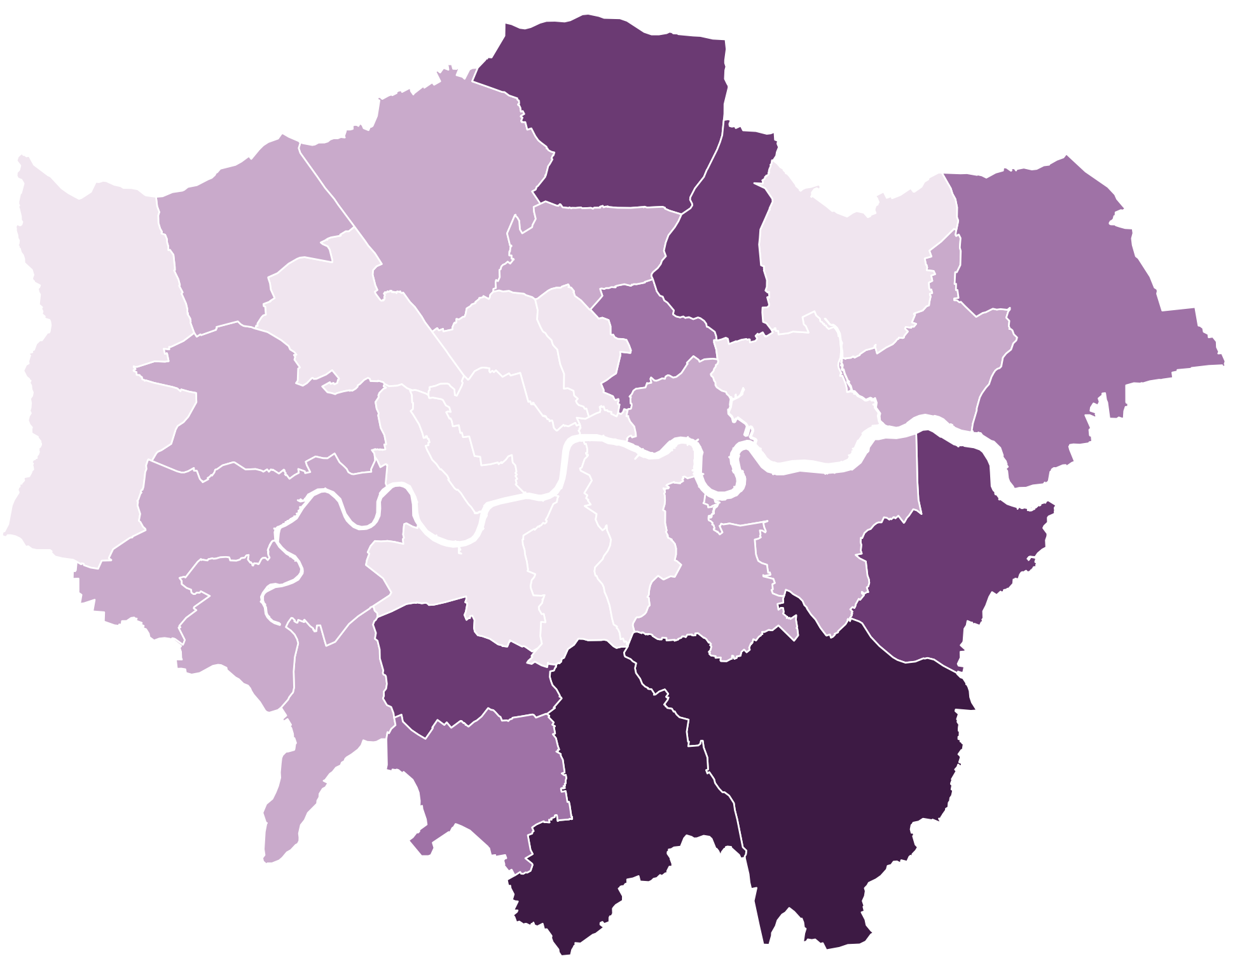
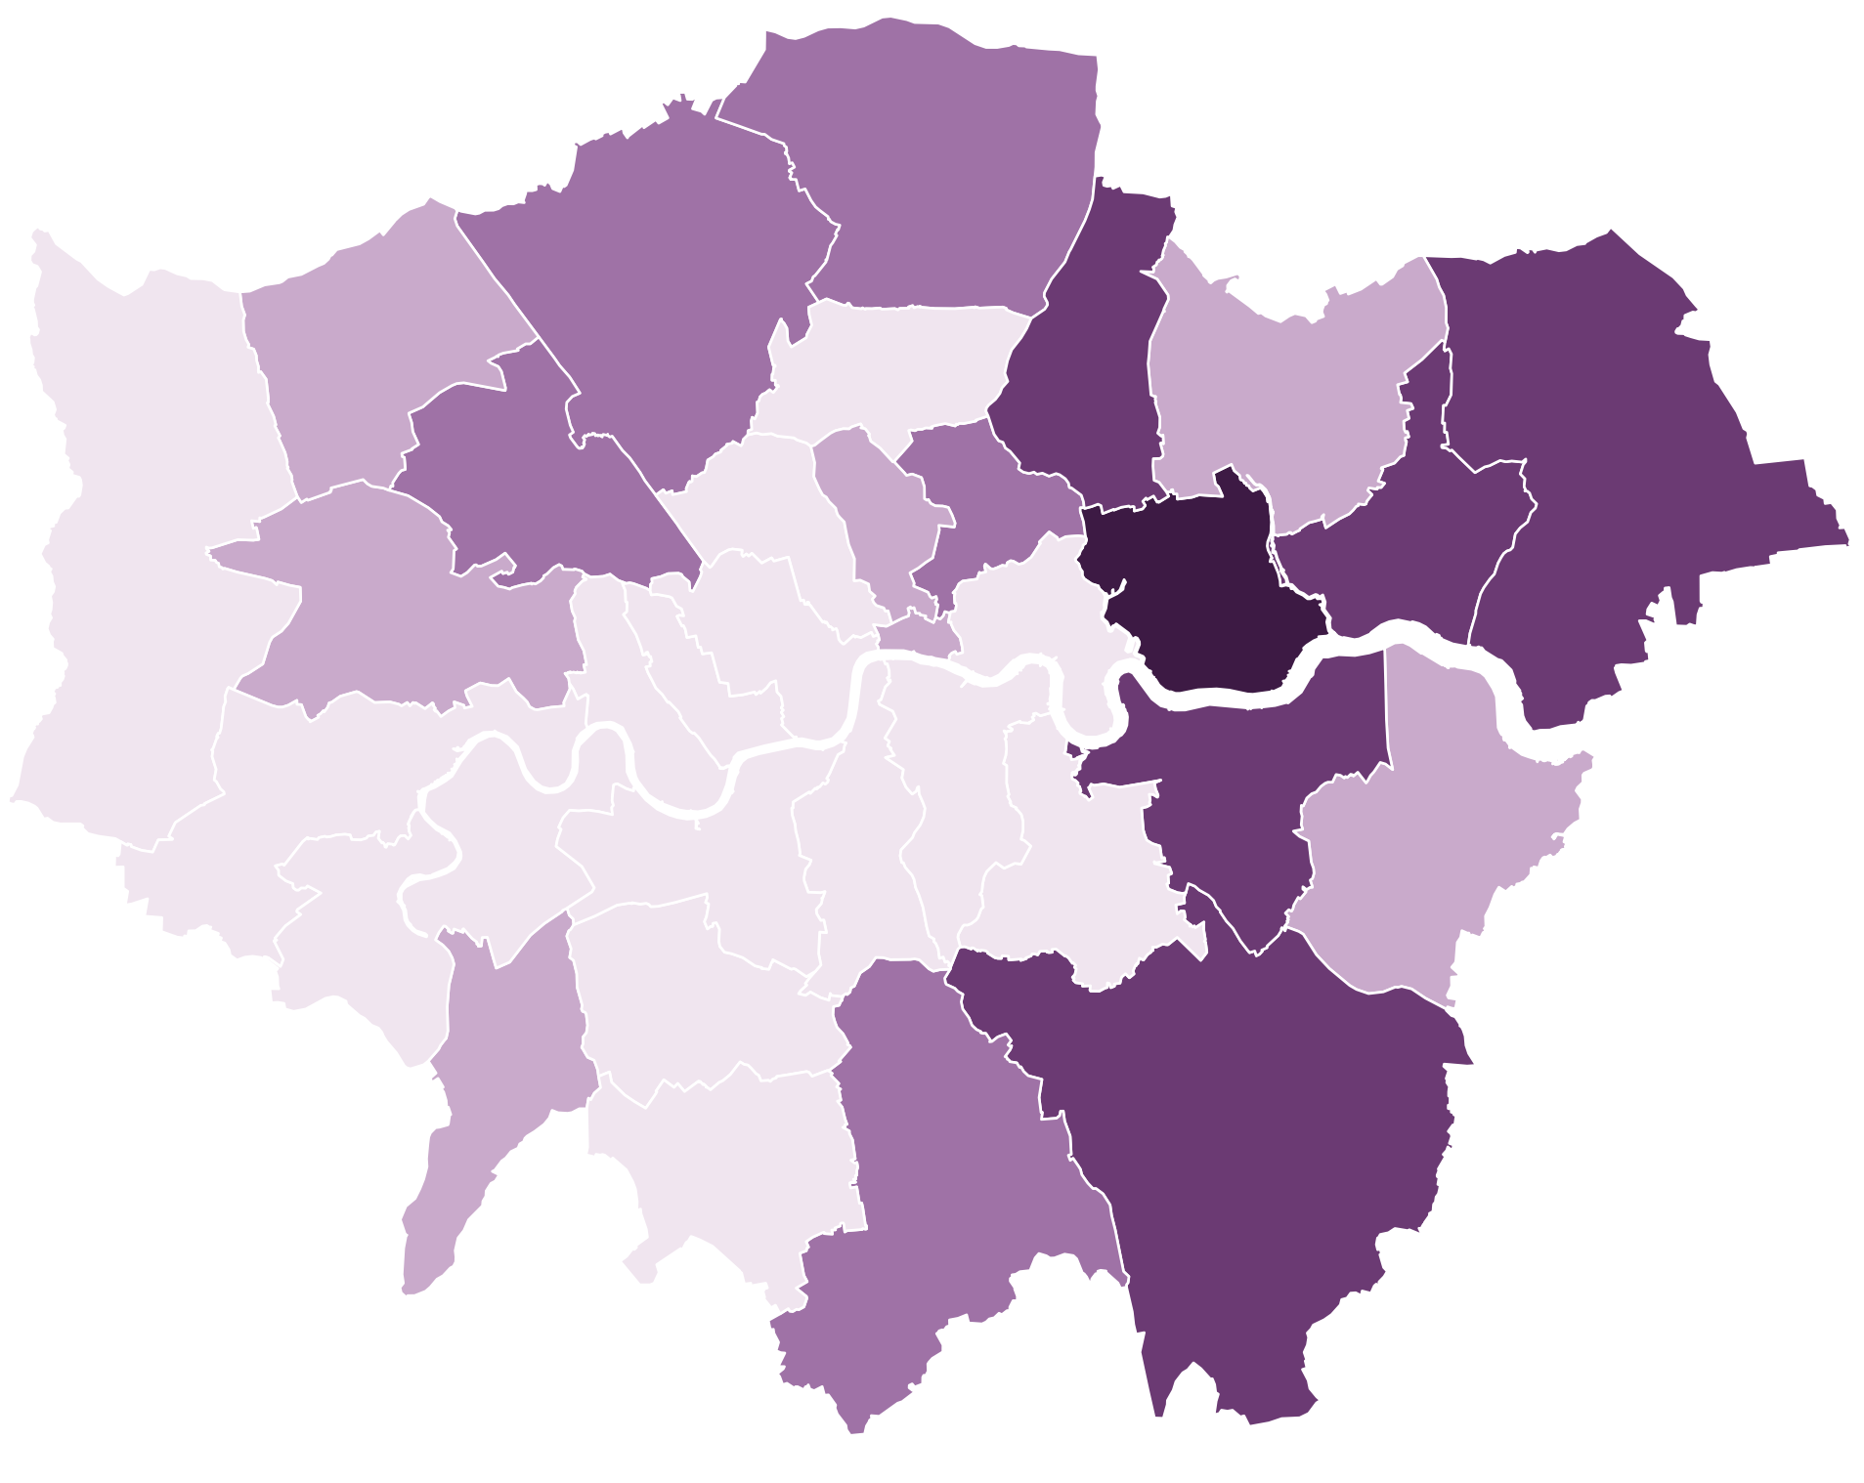
EHCP Rates in 2026 show slight regional pattern across Local Authorities
Growth since 2018 shows clear growth primarily affecting non-London Local authorities, map trends indicate that more extreme % changes across rates and Growth increase as we stray further from London
Higher rates cluster in the South West, East and parts of the North (the far North, and pockets of the North West and Yorkshire). Large majority of London boroughs sit in the two lowest bands.
The biggest increases — and the more modest ones — are both concentrated outside London. Within London, we see less clusters of lower growth across boroughs. With exception to Newham with the highest growth (302%)

Slide 4
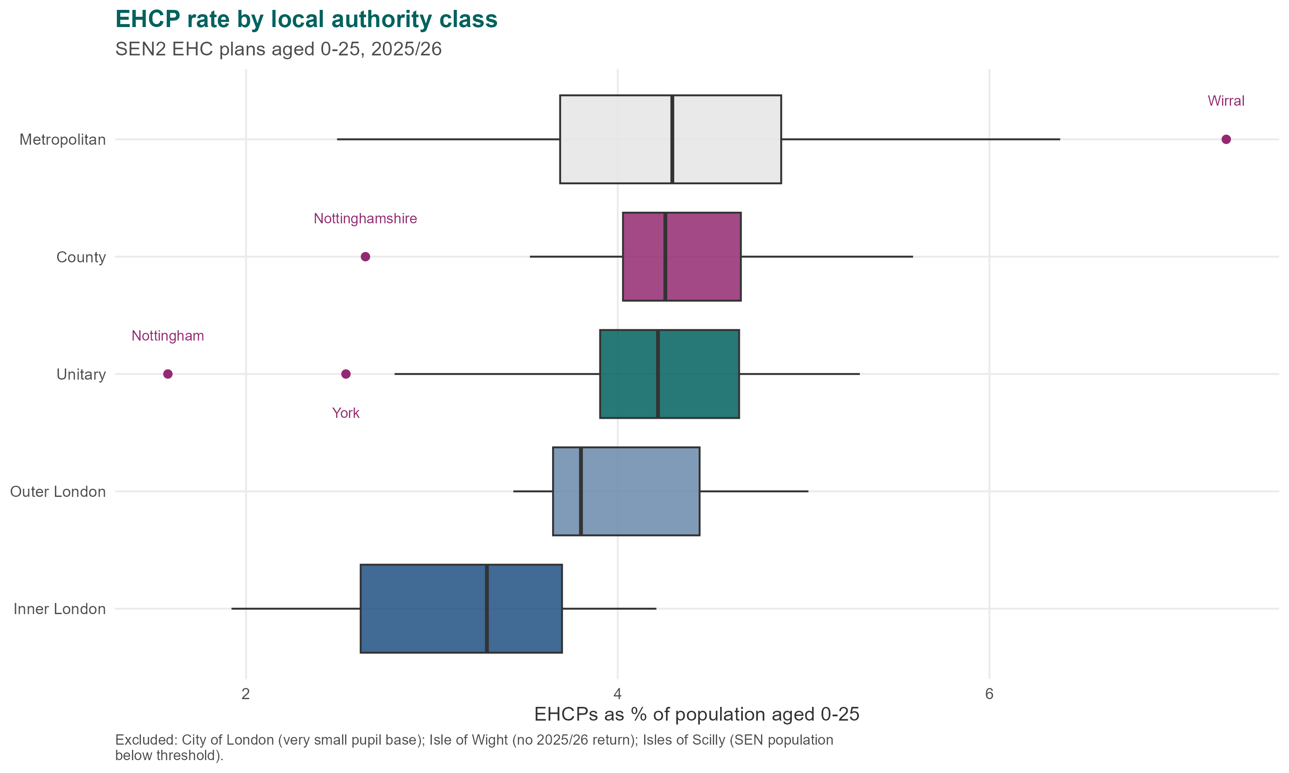
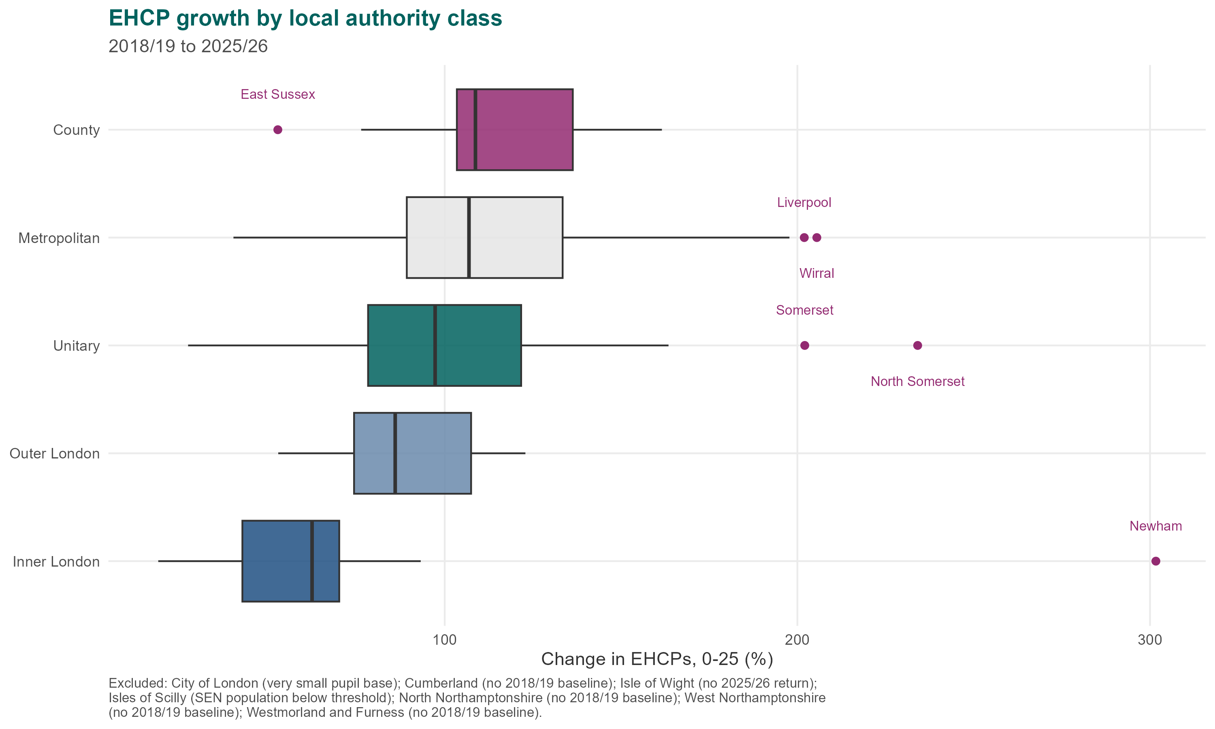
EHCP rates sit close to 4% of pupils in every type of local authority — the differences are between individual authorities, not between authority types
Median Rates span just 0.8% across 5 authority classes, less than the 1.0 points spread found within a typical class
• Growth ran far ahead in some authority types than others. Every class grew since 2018/19, but at very different speeds, a 47-point range top to bottom.
• Even so, today's rates are close across all classes. Current rates span just 3.3% (Inner London) to 4.3% (Metropolitan/County) — a 1.0-point gap. Back-calculating from today's rates and growth suggests all five classes started 2018/19 from a strikingly similar rate, around 2.0–2.1% — so even 109% growth only adds a couple of points on top of such a small base.
• Authority type is not the lever. Median rates run from 3.3% in Inner London to 4.3% in Outer London, against a national median of 4.1%. Half the authorities within any single class span a wider range than that. Policy aimed at a class of authority would miss where the variation sits.
Source: MHCLG analysis of DfE EHCP data and ONS mid-year population estimates.

Slide 5
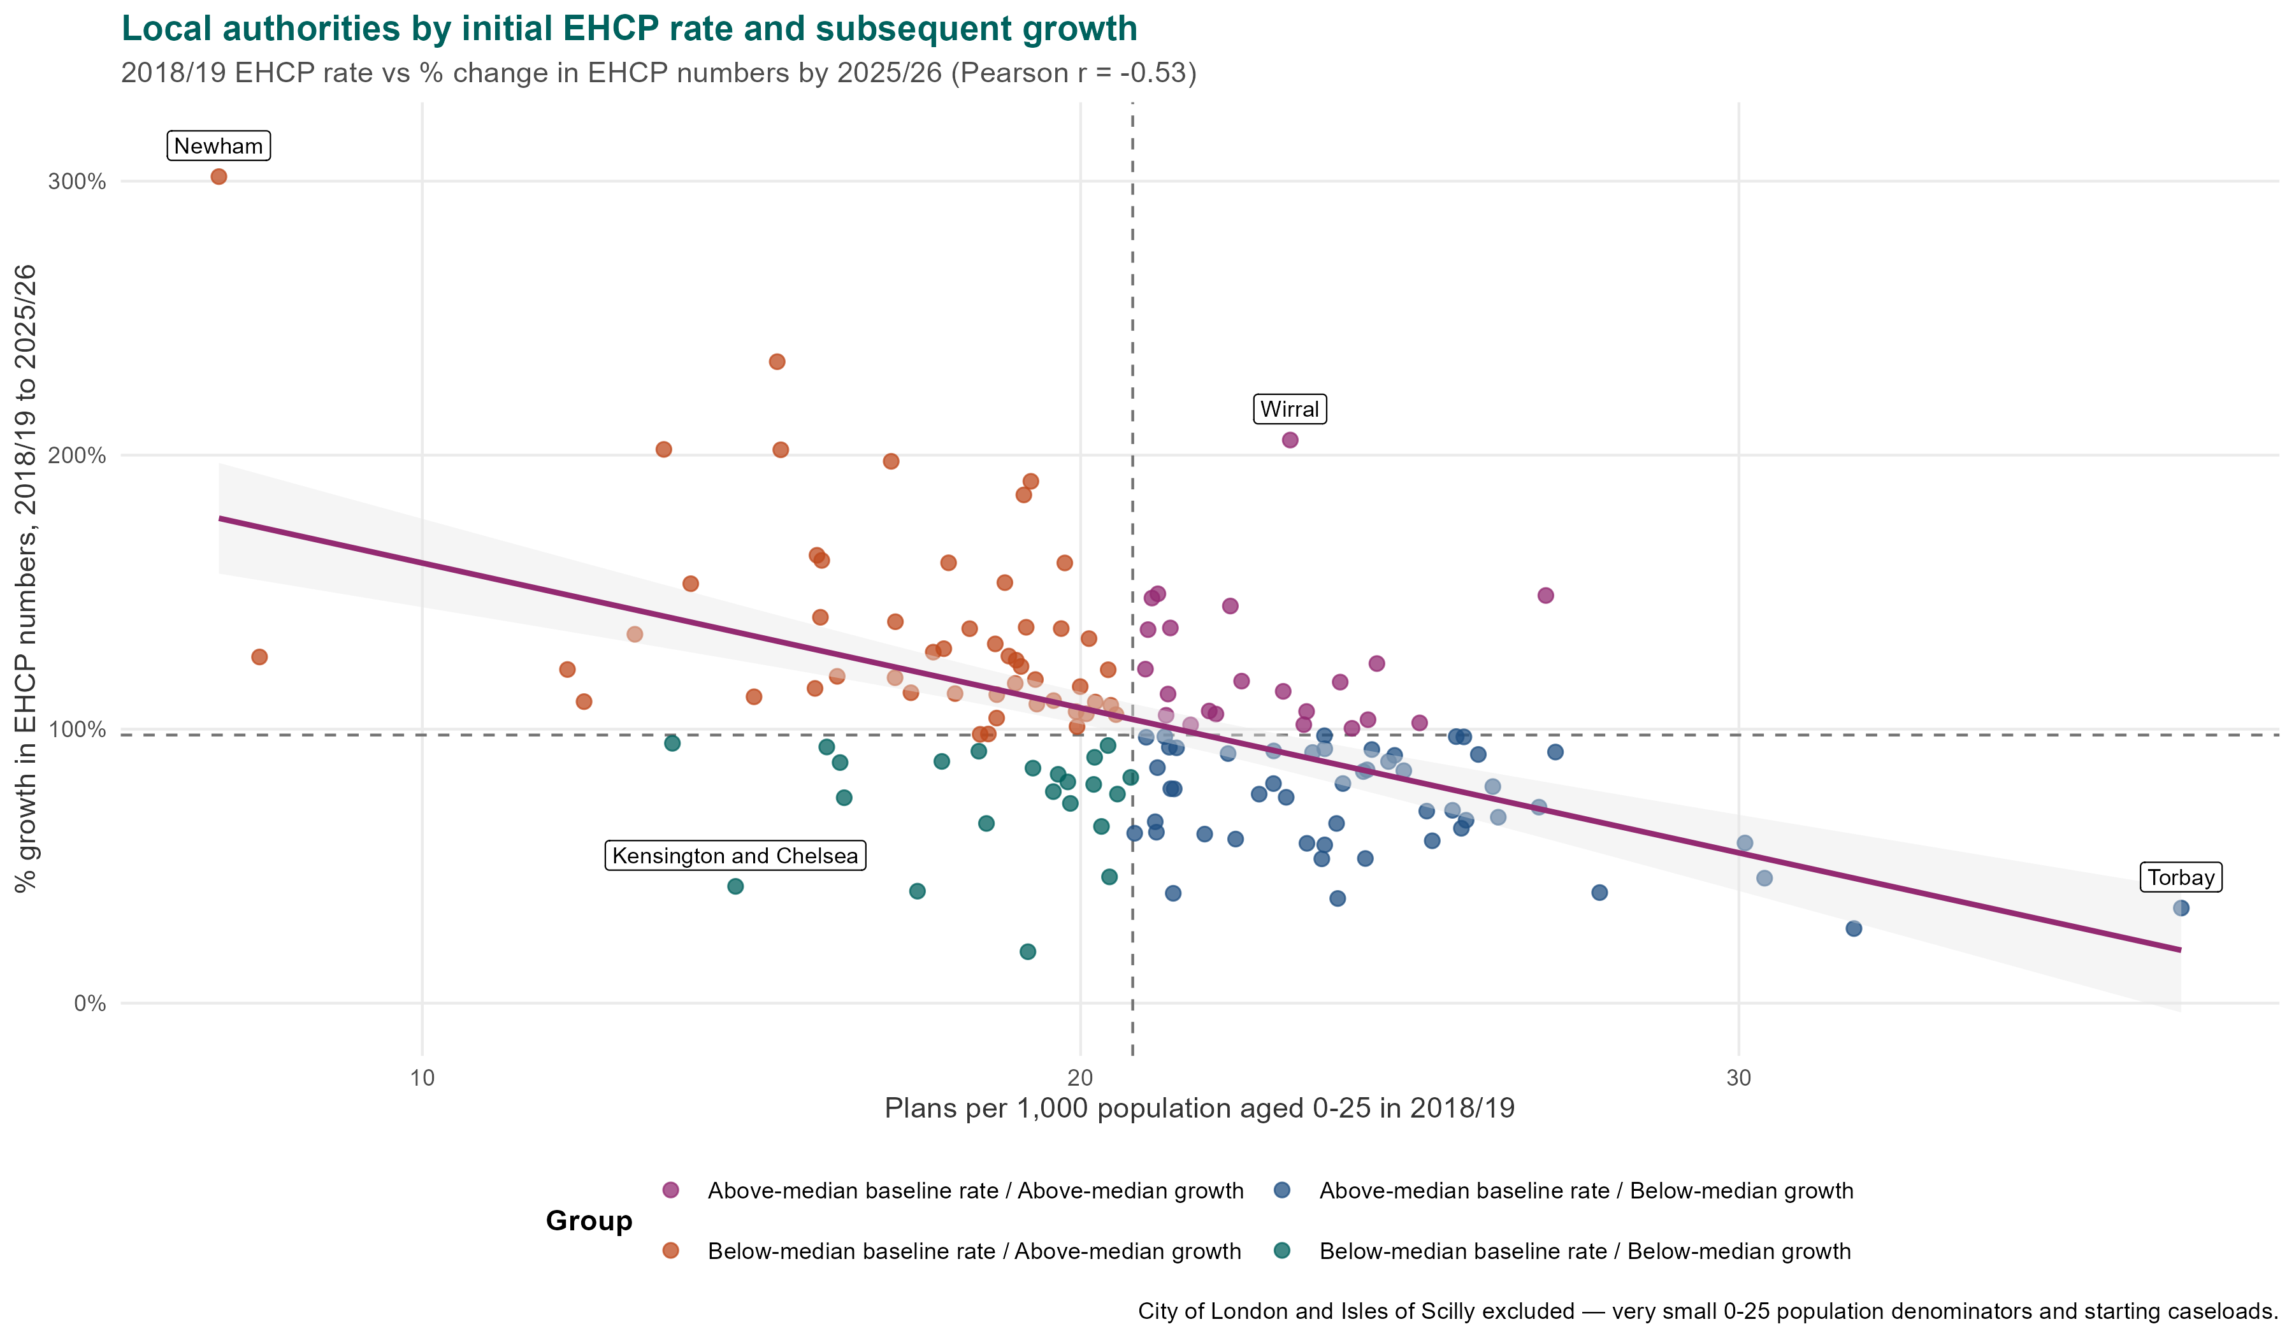
There is a moderate negative correlation between 2018 EHCP rates and subsequent growth
This means there has been some tendency for local authorities which had lower EHCP rates in 2018 to have experienced higher levels of EHCP growth
Below avg 2019 rate, Above avg growth
Catching up from a low base — where the negative correlation comes from.
Above avg 2019 rate, Above avg growth
Already high and still rising fastest — the sharpest pressure cases.
Below avg 2019 rate, Below avg growth
Consistently low provision relative to peers.
Above avg 2019 rate, Below avg growth
High but stabilising — may already be at a plateau.
Starting Position Still Matters
Authorities with higher rates in 2019 generally still have higher rates now, growth lower down has narrowed the gap but not closed it.

Slide 6
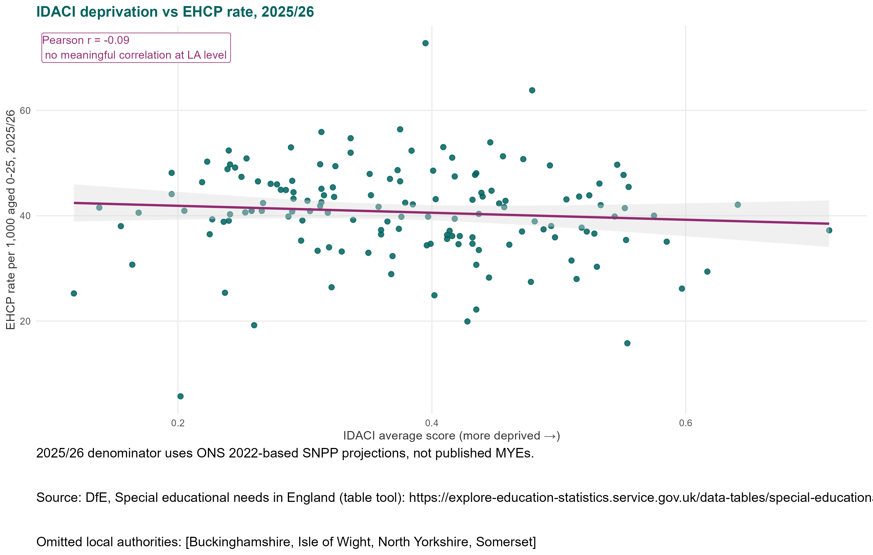
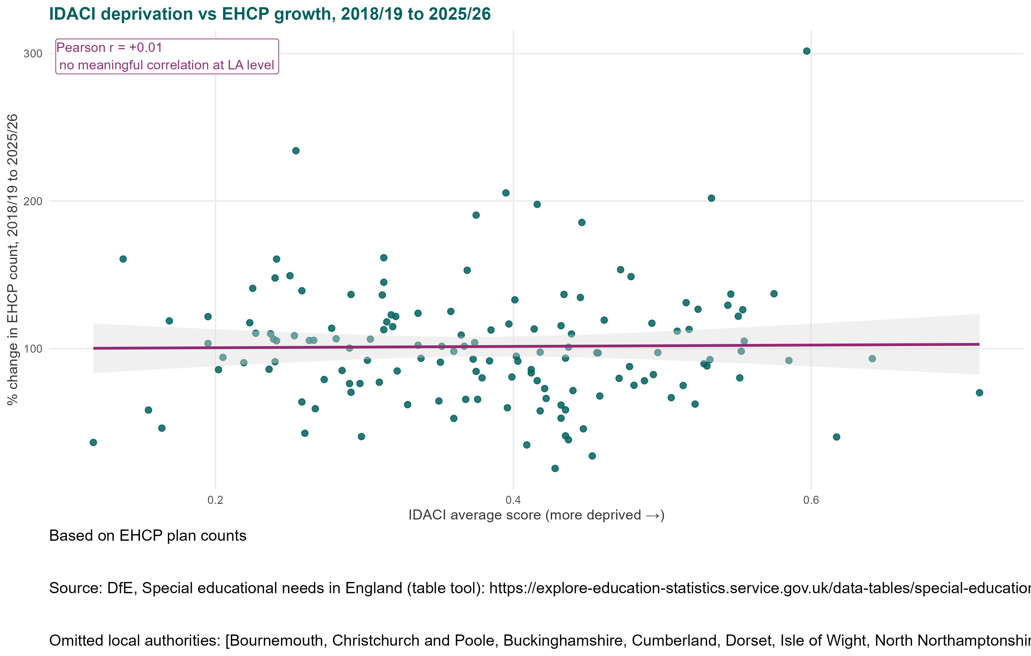
There is negligible correlation between deprivation* and EHCP rates at Local Authority level
Nor between deprivation and EHCP growth. Correlation suggests, the fastest growing Las are no more or less deprived than others
While there is no clear correlation between deprivation and EHCP rates or growth at LA level, children from more deprived backgrounds are nonetheless more likely to have identified SEND. 45.3% of pupils with an EHCP are eligible for free school meals, compared with 22.7% of pupils with no identified SEN (39.8% for pupils on SEN support). This itself raises questions as to why there is no correlation at LA level.
Source: MHCLG analysis of DfE EHCP data and English Indices of Deprivation (IDACI). FSM figures: DfE, Special educational needs in England (school pupils only), Explore Education Statistics
*Deprivation measured via the avg. IDACI score.

Slide 7
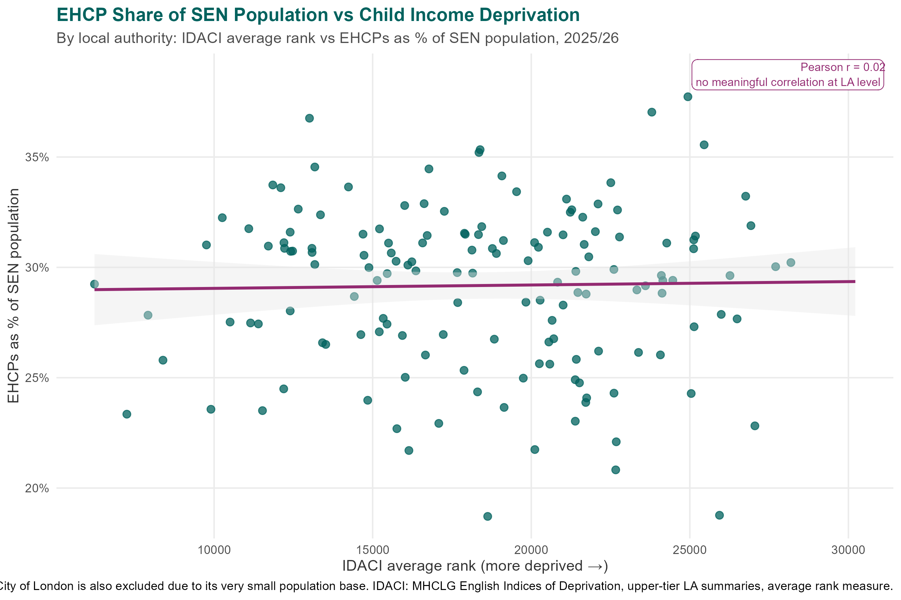


Deprivation and EHCPs as a share of the SEND population
Deprivation and EHCP share are unrelated at Local Authority Level (r = 0.02), flattest correlation in the pack.
Not how many children hold plans, but what share of the identified SEN population is converted into a plan.
A positive correlation would mean more deprived LAs issue plans to a smaller share of their SEN population — the opposite of what need alone would predict, and a cause for concern.
The share of an authority's identified SEN cohort holding a statutory plan sits at roughly 29–30% whether the area is among the most or least deprived.
No such pattern is visible in the data. Worth revisiting if the relationship emerges in future years.
Note: this dataset covers school pupils only and is not directly comparable with the 0–25 EHCP population used elsewhere in this pack.

Slide 8
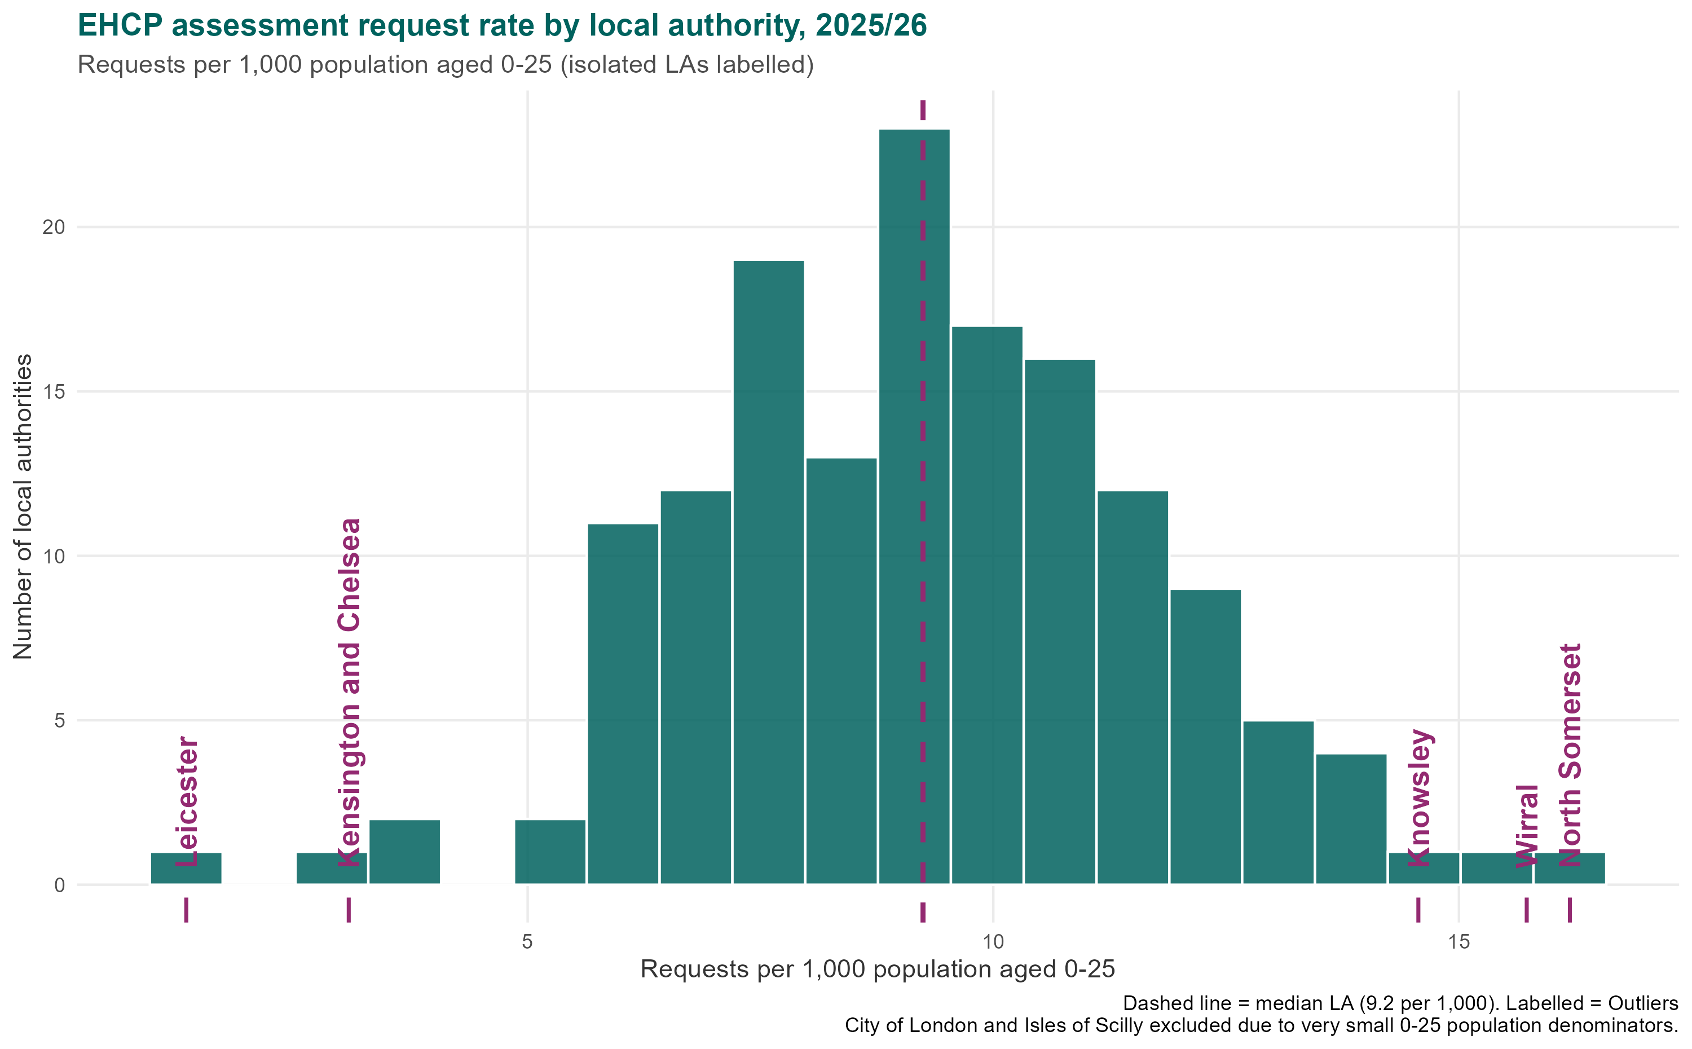
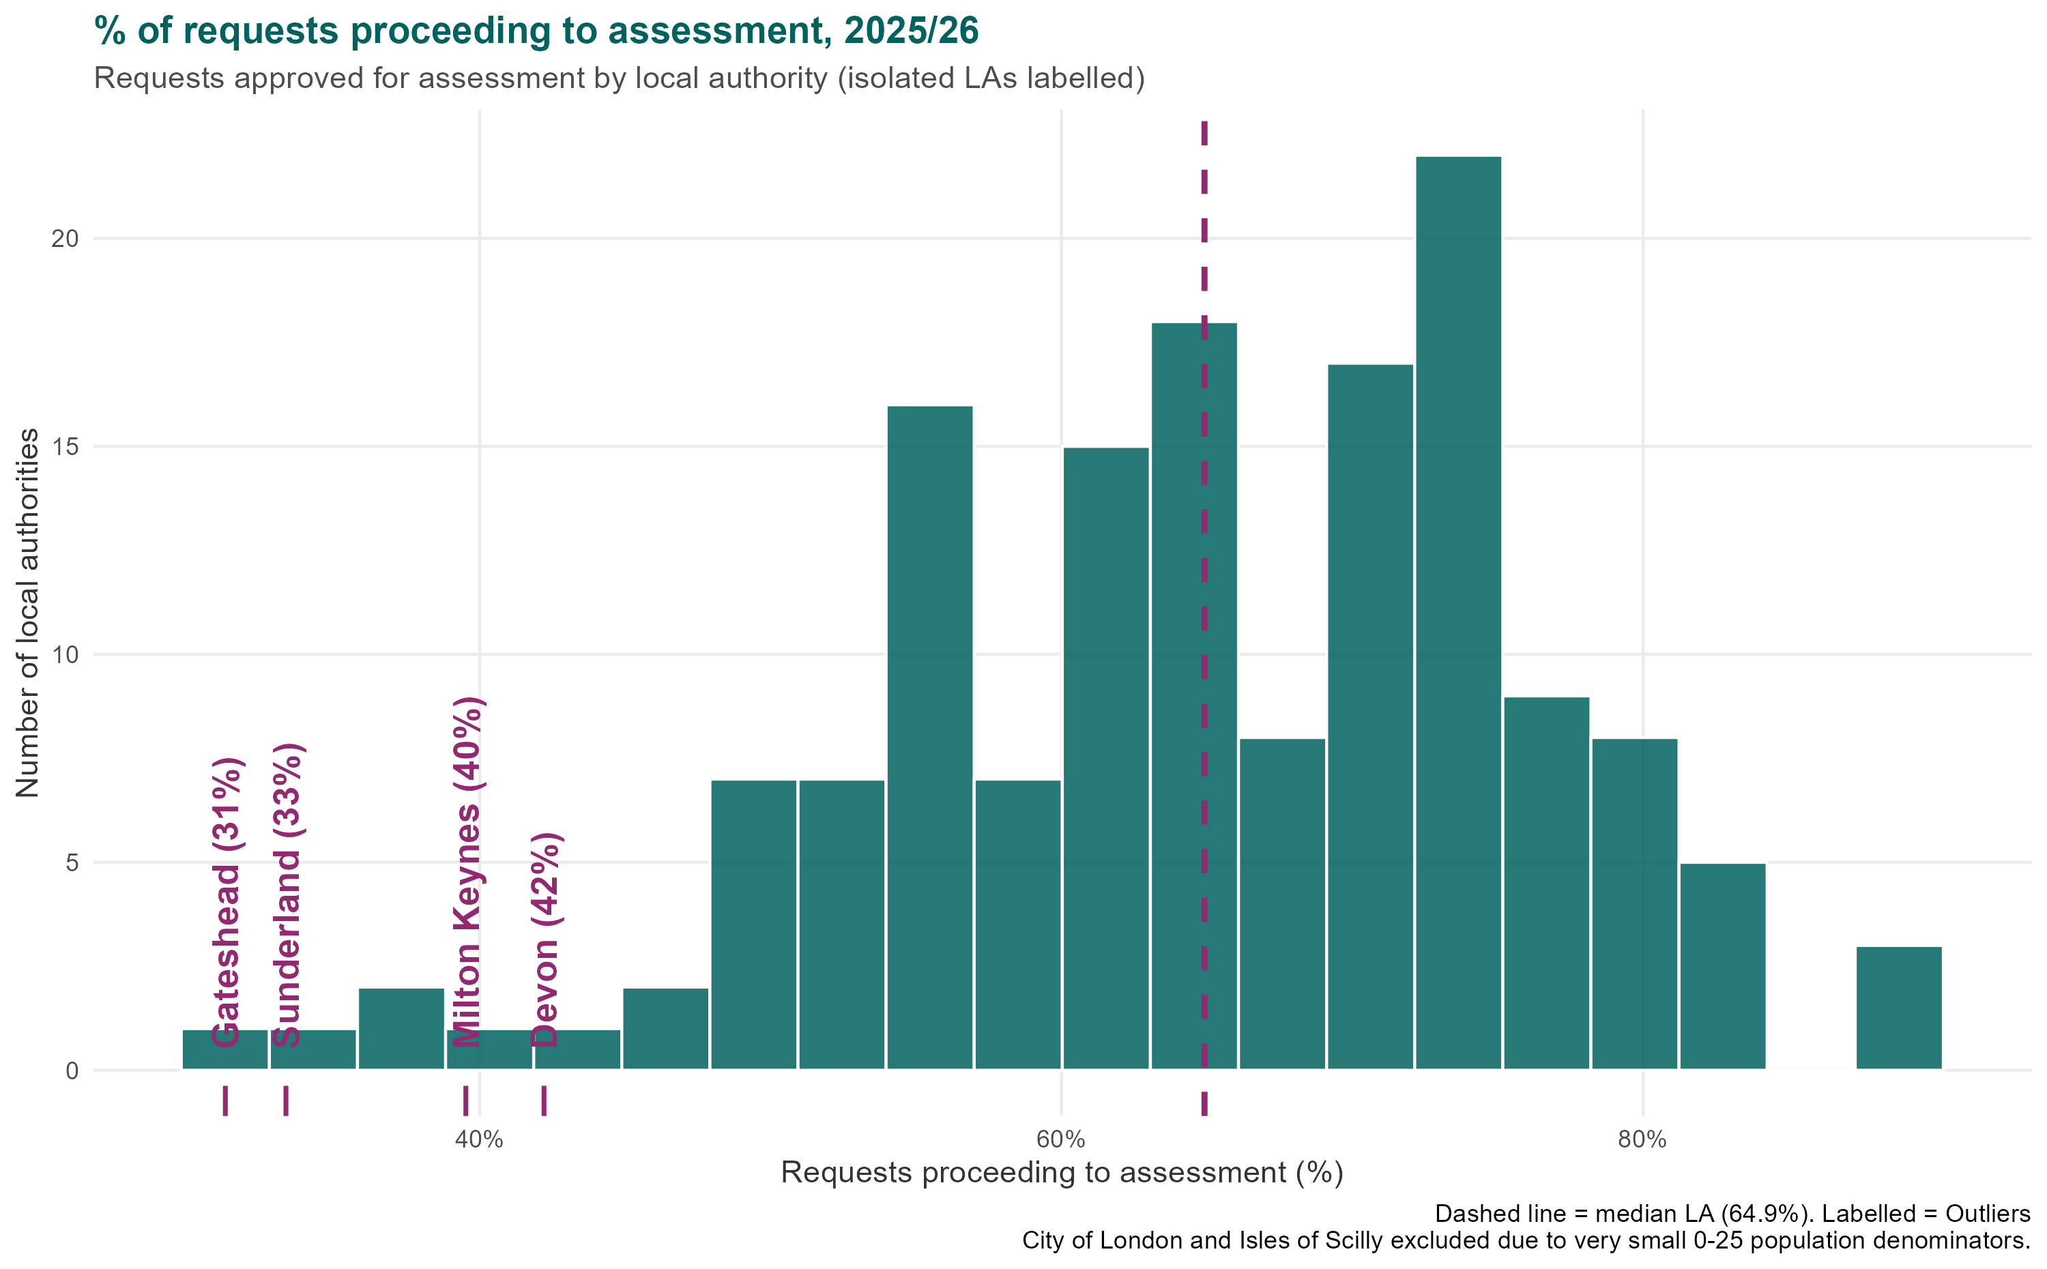
How local Authorities handle EHCP requests varies sharply – and stricter gatekeeping is linked to more tribunals
The median LA approved 68% of requests for assessment, ranging from 26% to 96% across authorities
Request rate is the strongest single correlate of EHCP rate in the dataset — see slide 9.
A lower approval rate at this gate is linked to a higher tribunal rate— see slide 9.

Slide 9
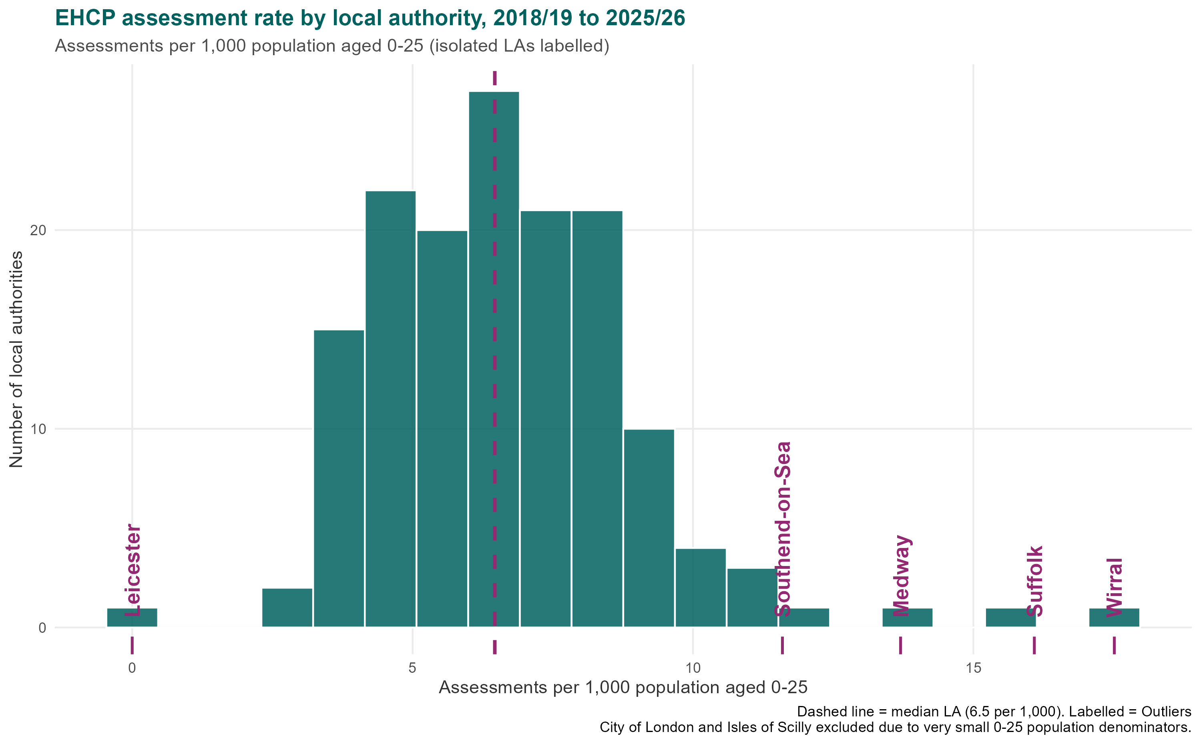
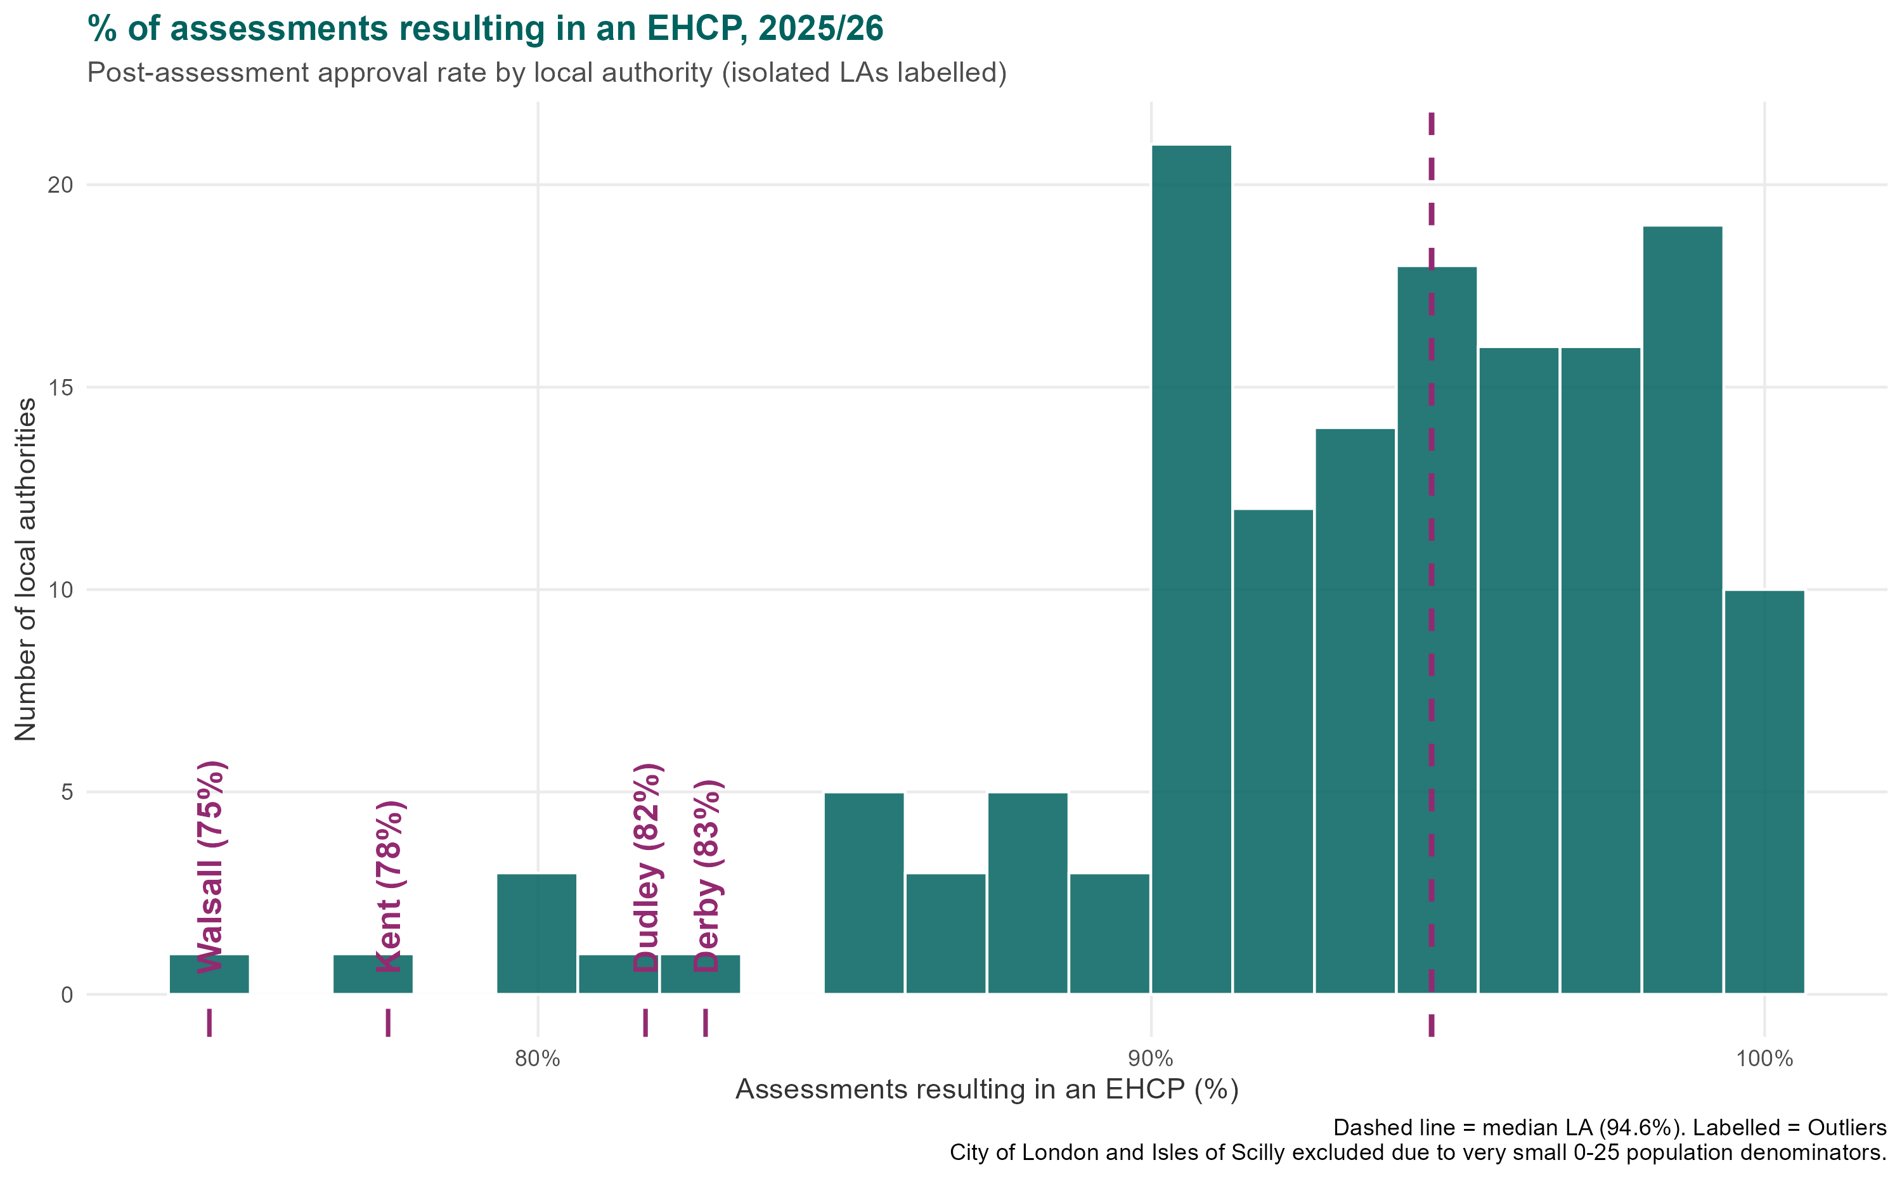
The median LA completed 6.5 EHCP assessments per 1,000 of the 0–25 population
Most assessments result in a plan — rates cluster at 95–100%, but a long tail of authorities sits well below
Almost all of the filtering happens before assessment, not after it. The typical local authority approves 65% of requests for assessment, but issues a plan in 95% of the assessments it completes. Once a child is assessed, a plan is very likely.
The first gate also varies far more than the second. Approval for assessment ranges from 26% to 96% across areas — a near four-fold difference — while post-assessment approval clusters between 90% and 100% nearly everywhere. Where a family lives matters much more to whether a child is assessed than to what happens afterwards.
This points to gatekeeping at the request stage. A 95% approval rate after assessment suggests most refused requests would have met the threshold had they proceeded. Areas refusing more at the first gate also show higher tribunal rates (slide 9).

Slide 10
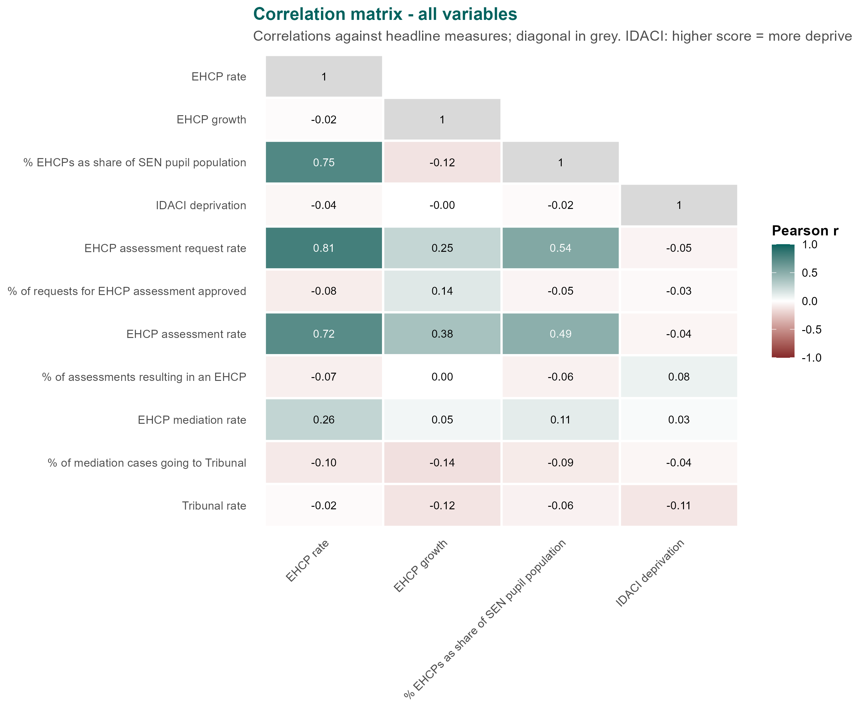
Request Rate and Assessment Rate are strongly Correlated with EHCP rate
Approval, mediation and tribunal measures show weak or negligible correlation with EHCP rate, growth and deprivation
Correlations worth noting
Throughput drives levels. Request rate (0.81) and assessment rate (0.72) are the strongest correlates of EHCP rate, and both track the EHCP share of the SEN cohort too.
Plans are displacing SEN support. Where the EHCP rate is higher, a larger share of identified SEN pupils hold a statutory plan (0.75) — the same authorities, not simply larger cohorts.
Levels and growth are separate stories. EHCP rate and growth since 2018/19 are unrelated (−0.02); growth tracks assessment activity (0.38) and request volume (0.25) instead.
Decisions and deprivation don't move the totals. Both approval rates correlate weakly with EHCP rate (−0.08, −0.07) and growth (0.14, 0.00), and IDACI deprivation is flat against every measure (strongest |r| = 0.11).
Volume entering the process is the common thread — not deprivation, approval decisions or escalation.
Source: MHCLG analysis of DfE EHCP, request and tribunal/mediation data. Pearson correlation

Slide 11
End slide

Slide 12
Conclusion + QnA slide?

Slide 13
Annex A
Additional EHCPS as a share of send plots

Slide 14
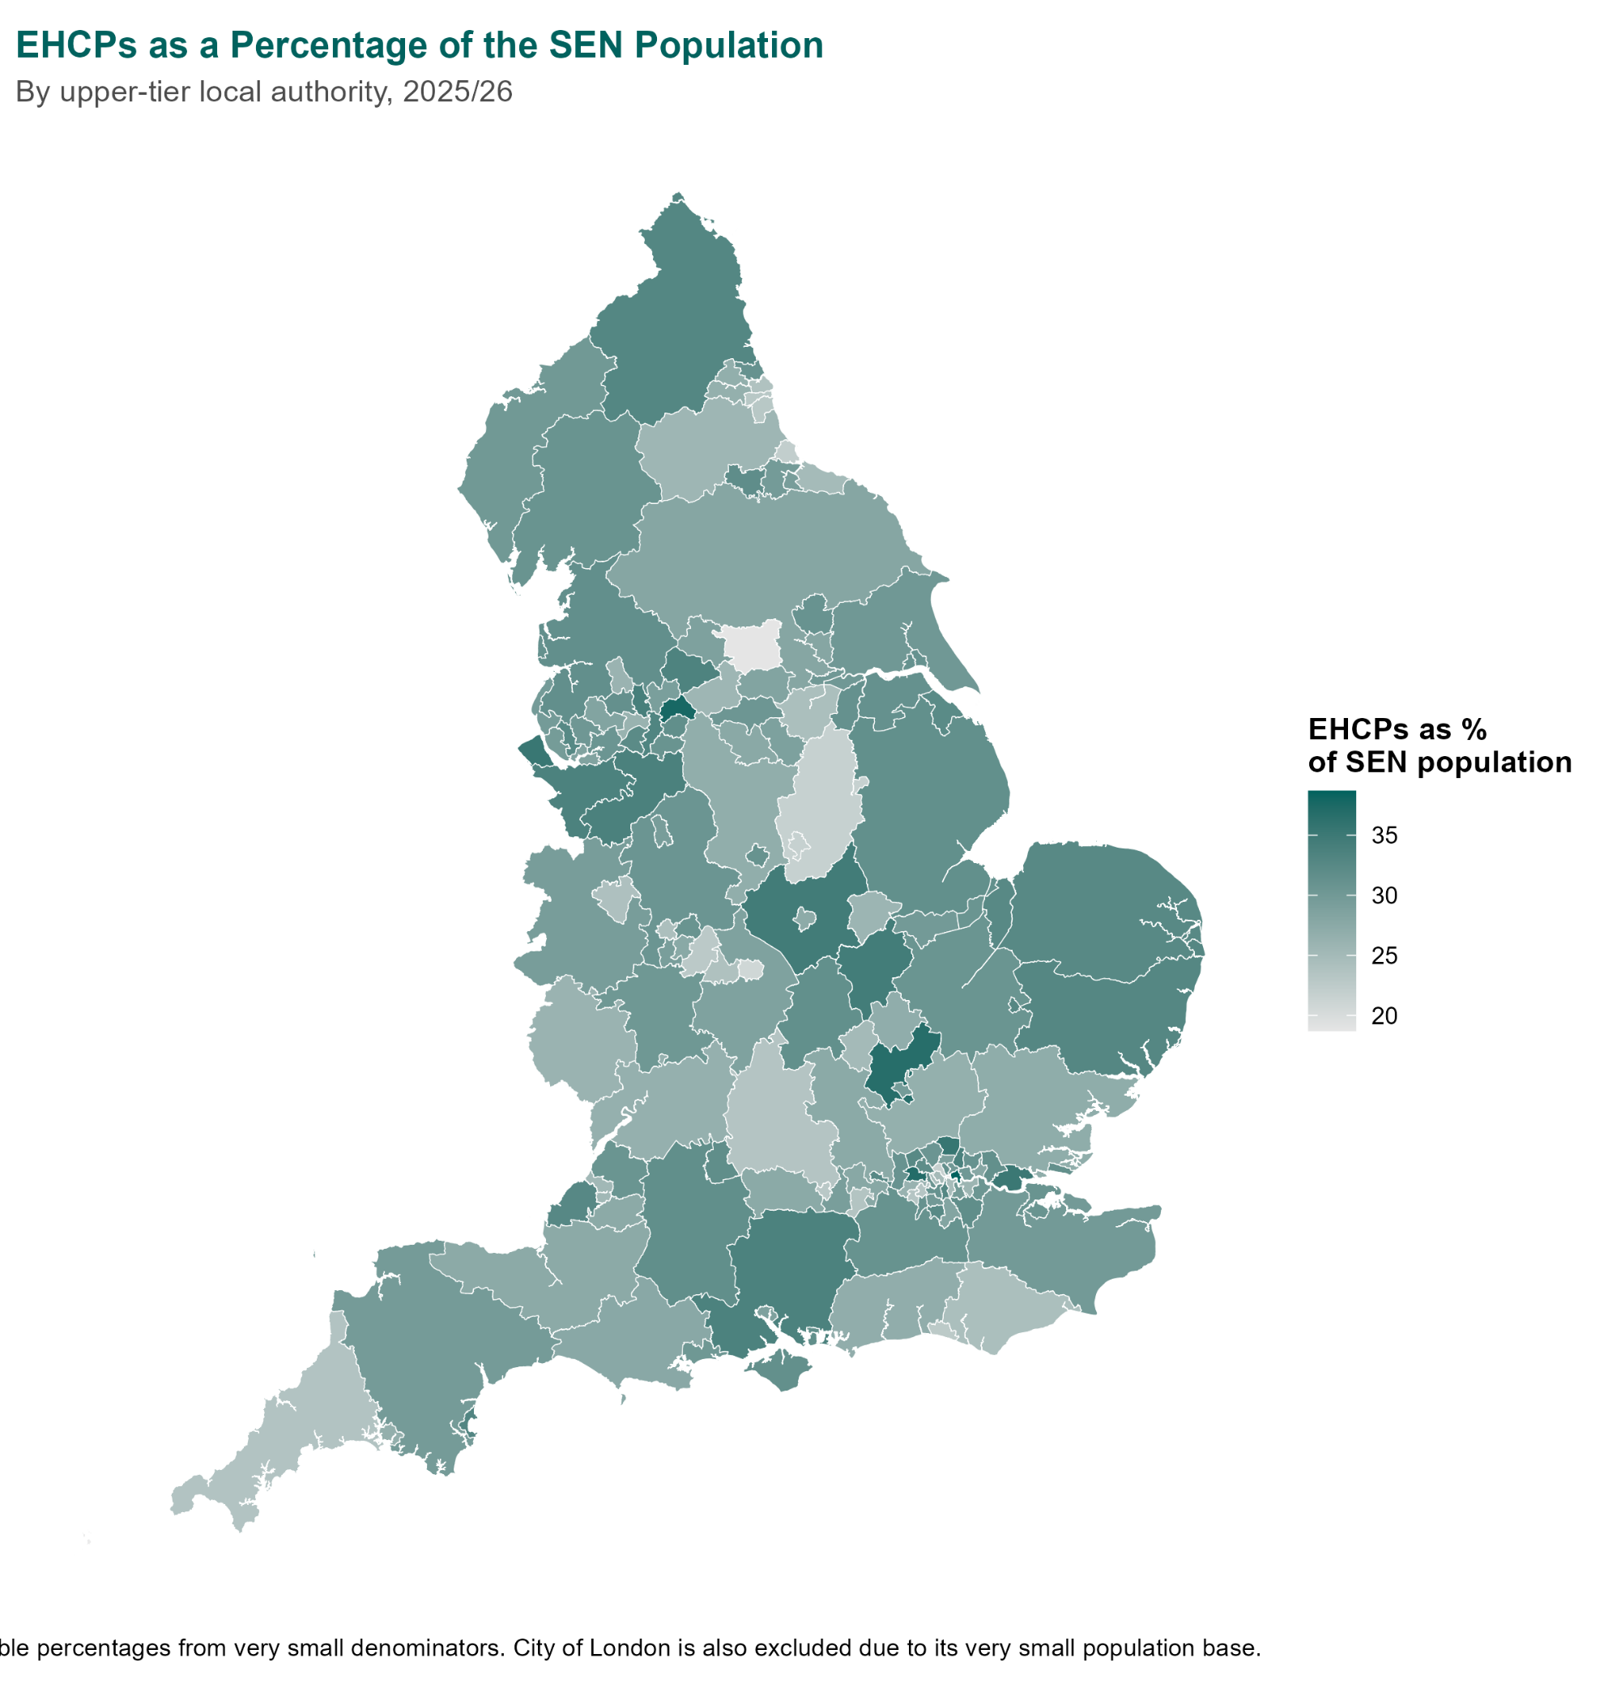
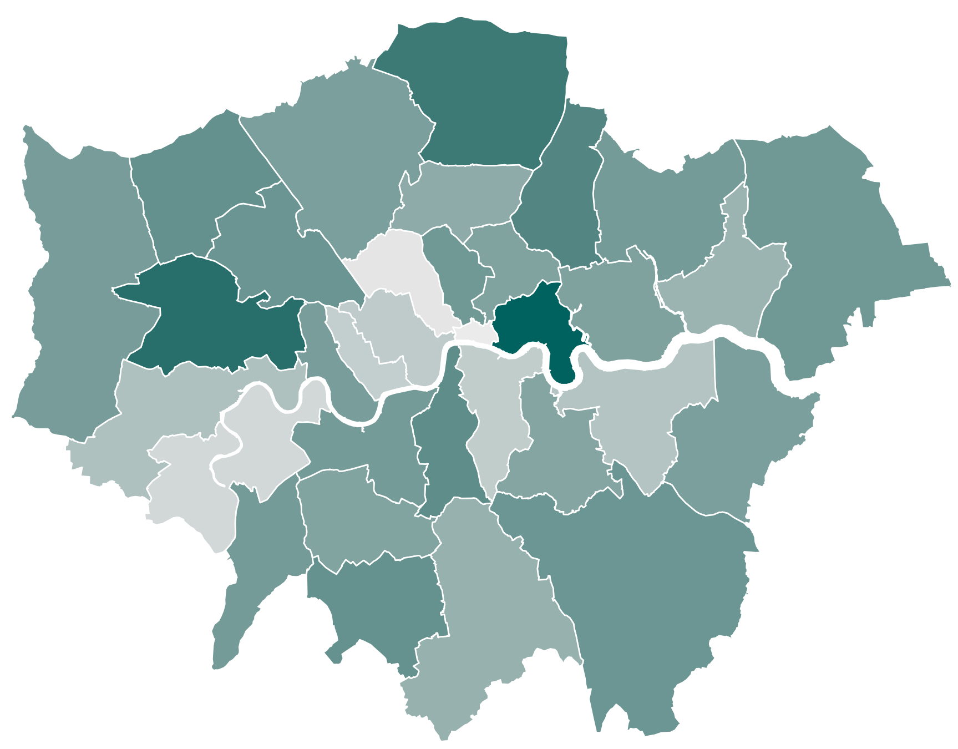
Deprivation and EHCPs as a share of the SEND population
Not how many children hold plans, but what share of the identified SEN population is converted into a plan.
A negative correlation would mean more deprived LAs issue plans to a smaller share of their SEN population — the opposite of what need alone would predict, and a cause for concern.
If that pattern holds it may reflect more successful lobbying and appeals in more affluent areas
Note: this dataset covers school pupils only and is not directly comparable with the 0–25 EHCP population used elsewhere in this pack.

Slide 15
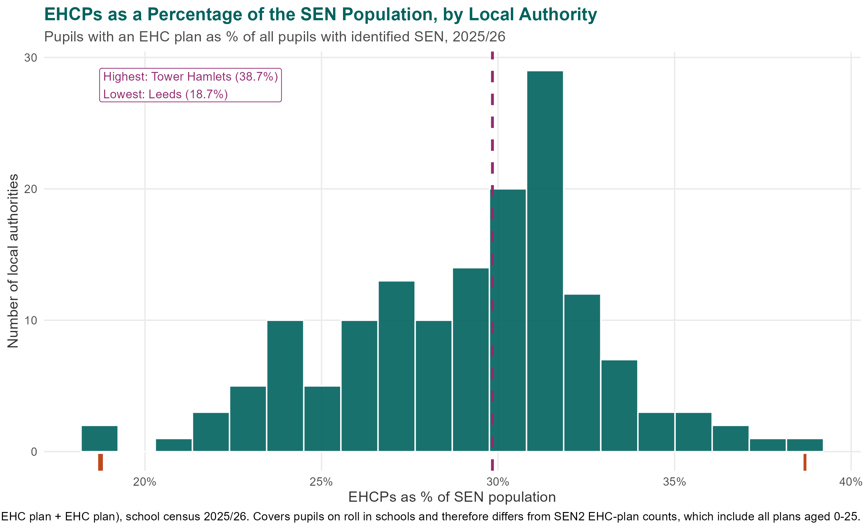
Deprivation and EHCPs as a share of the SEND population
Not how many children hold plans, but what share of the identified SEN population is converted into a plan.
A negative correlation would mean more deprived LAs issue plans to a smaller share of their SEN population — the opposite of what need alone would predict, and a cause for concern.
If that pattern holds it may reflect more successful lobbying and appeals in more affluent areas
Note: this dataset covers school pupils only and is not directly comparable with the 0–25 EHCP population used elsewhere in this pack.

